Slide 2
Food Culture and Biodiversity Conservation
Dessislava Dimitrova, Teodora Ivanova
Institute of Biodiversity and Ecosystem Research, BAS
Slow Food

Slide 3
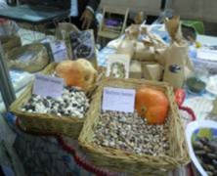
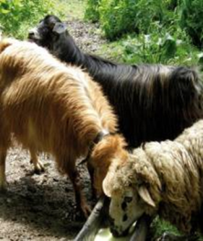
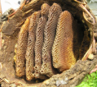
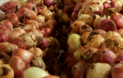
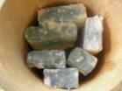
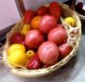
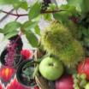
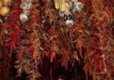
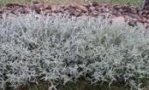
Traditional Knowledge, Innovations and Nature Conservation
Identification – Collaboration – Valorisation/Innovation
Preservation of local plant genetic resources
Processed fruit and vegetable preserves – ethnobotanical studies and valorisation
Autochthonous animal breeds, pastoralism and conservation of grasslands Biological activity of traditional milk products
Changing landscapes: transformations and perceptions in rural areas
Local communities & researchers –
partners for preservation of traditional knowledge and nature conservation

Slide 4
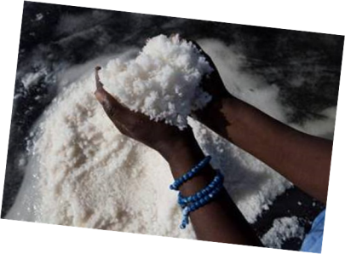
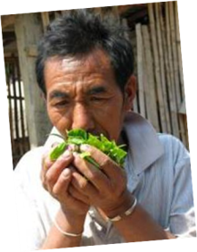
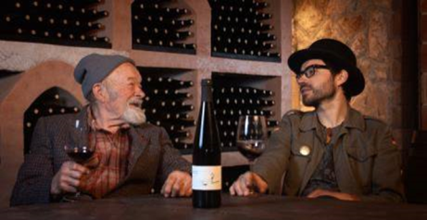
Nature Conservation, Food Culture, Globalization
Quality food – accessibility, sovereignty, organic/nature friendly, luxury?
Global agenda and local perspectives – Do we know our food?
World hunger vs. food waste – awareness and grassroots actions
Involvement and networking – Slow food as a driver

Slide 5
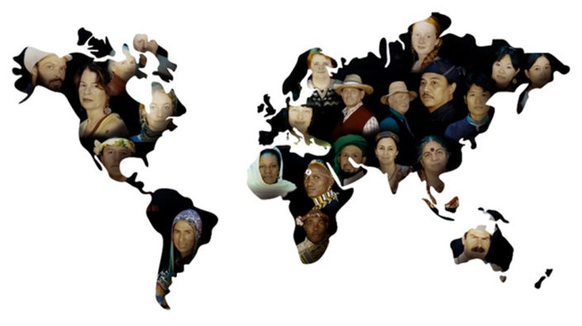
Slow Food Network
163 countries
1 000 000 supporters in 3 000 local groups
Over 9 000 events a year
1 event every hour!

Slide 6
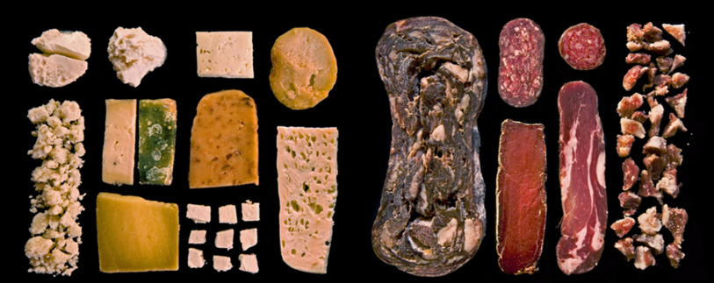
Biodiversity Projects of Slow Food
Ark of Taste – e-catalogue of endangered traditional foods: 5405 products
Presidia – sustain quality food at risk of extinction: 505 presidia
Earth Markets – international network of farmers’ markets: 56 markets
Chefs Alliance of Slow Food – chefs defenders of food biodiversity

Slide 8
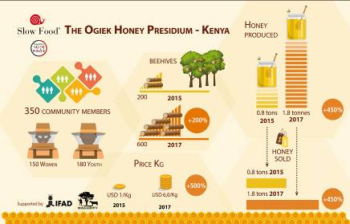
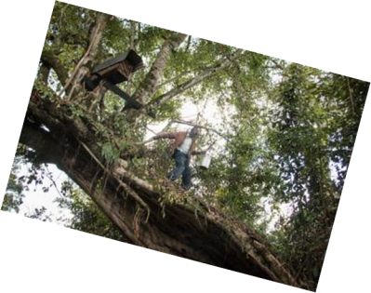
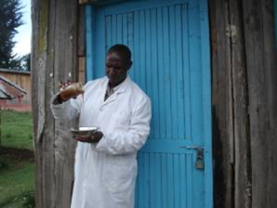
Ogiek Honey Presidium Kenya
Mau Forest ecosystem threatened by degradation and destruction
since the early 1900s for wood exploitation
since the 1980’s for tea and flower plantations, coal mining, forestry
Ogiek life style
hunter- gatherers
apiculture, crops cultivation and stock breeding
clans sustainably manage the forest
Maintenance of Mau forests
planting native trees
recently won an 8-year legal battle to live in the forest
beekeeping - important economic activity for Ogiek youth and their communities

Slide 9
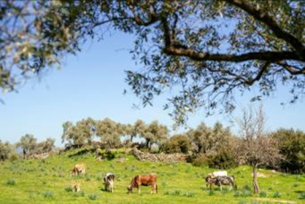
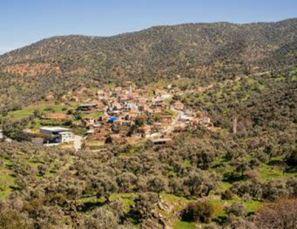
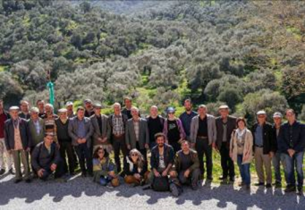
Extra-Virgin Olive Oil and Aegean Indigenous Landscapes
Description:
Wild olive trees along the Anatolian coastline are grafted with 2 local olive varieties
Co-existing of wildlife and olive-oil production
Groves are accessible for grazing by livestock and wild animals (co-management system known as Orfene).
Groves are not irrigated, no of chemical fertilizers and pesticides
Olives are picked by hand or with equipment that does not damage the fruit
Dangers:
Construction activities
Infrastructure projects
Intensive olive cultivation – productive varieties
Plantations fenced and irrigated

Slide 10
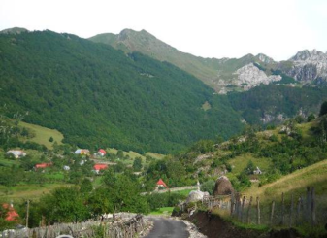
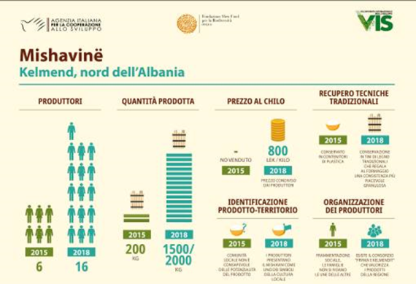
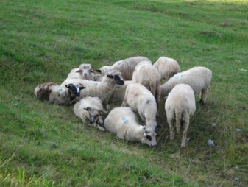
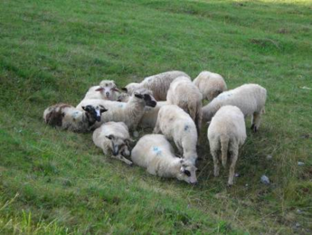
Mishavinë Cheese Presidium Albania

Slide 11
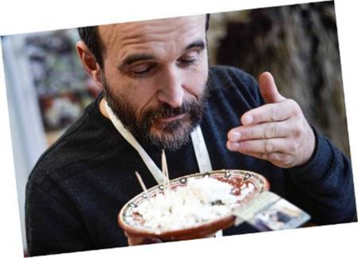
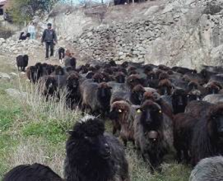
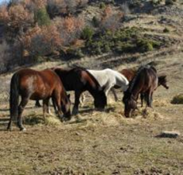
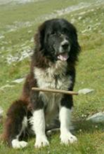
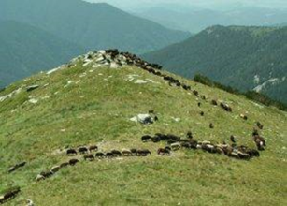
Karakachan Sheep Presidium, Bulgaria
In the early 20th century there were 500,000 Karakachan sheep in Bulgaria by late 1950s the number shrunk to 160,000 today – less than 10000
A project to save Karakachan sheep and the accompanying specific horse and dog breed
Restoring transhumance practice – grazing in Pirin National Park to sustain high mountain pastures
50-60 liters of milk per sheep per season (fat content of 6.5 to 8%)

Slide 12
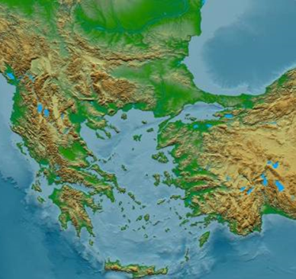
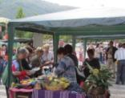
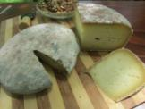
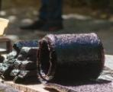
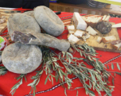
Slow Food Balkans
Launched in 2010
Balkan countries and Turkey
Biennial Terra Madre Balkans regional meeting – 5 editions
Over 1500 Slow Food members, 60 chefs, 50 experts
103 Slow Food Convivia and over 100 food communities
348 Ark of Taste products
24 Slow Food presidia
15 educational programs
Focus: food biodiversity, artisan food producers, agroecological production
Function: credible promoter of sustainable food system in the region

Slide 13
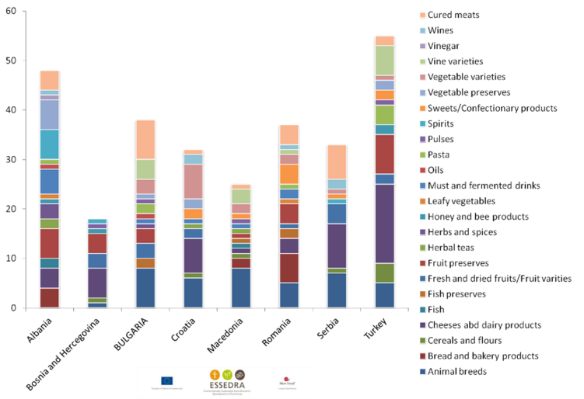
ESSEDRA Project and Food Diversity in the Balkans

Slide 14
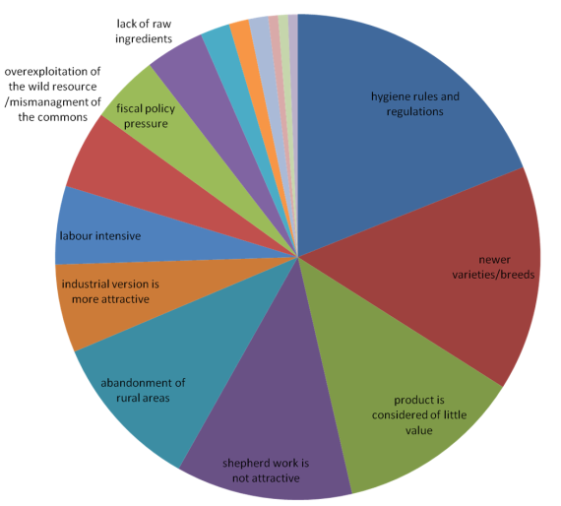
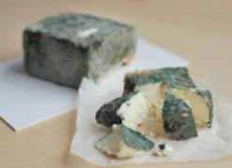
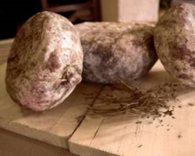
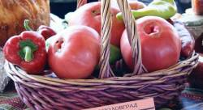
Threats for Biodiversity

Slide 15
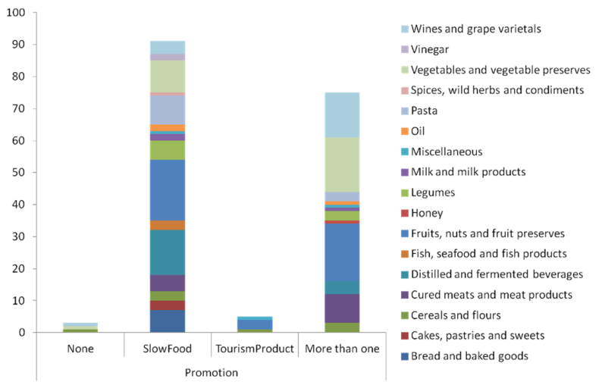
Business – Promotion – Sustainability

Slide 16
Biosphere Reserves - Food for Thought and Thought for Food

Slide 17
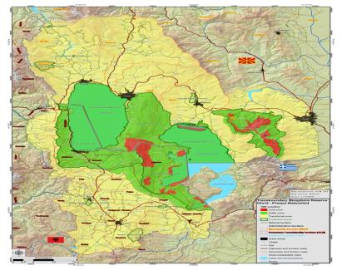
Ohrid-Prespa Transboundary Biosphere Reserve
Challenging circumstances | Biosphere reserve & Slow Food
455,000 inhabitants, cultural, ethnic and religious diversities | Shared food habits – territory and its conditions are most important
Intensive fruit cultivation (Resen, N Macedonia), and agriculture (Korca) | Ark and presidia – awareness about food biodiversity and TEK
Food processing industry | Ark and presidia – awareness about traditional products and their preservation
Stockbreeding (Albania and N Macedonia) | Ark products and presidia – local breeds and breeding practices as management tools for BR
Tourism | Slow Travel – promotion of food traditions and preservation of natural resources by tourists
.

Slide 18
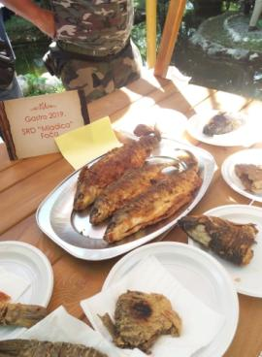
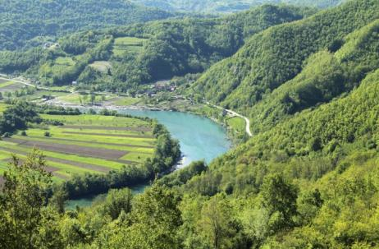
Tara River Basin
Mladica (Hucho hucho) – endemic to the Danube and its tributaries (Tara river, Bosnia and Montenegro)
Fruit varieties and processing of fruits
Cheese traditions and preservation of stock breeding traditions
Slow Food tools and BR management
Cooperation between food communities in MNE & BiH – cross-border BR
Ark products – raising awareness of local people for the value of food bidoiversity
Cross-border presidia for Mladica fish
Cross-border presidia for cattle, cheeses and mountain grasslands
Slow Travel – tourist packages in support of local food traditions
Food diversity - connection to territory – better motivation for conservation

Slide 19
Thank You for Your Attention!
This work has been carried out in the framework of the National Science Program
“Environmental Protection and Reduction of Risks of Adverse Events and Natural Disasters”
approved by the Resolution of the Council of Ministers № 577/17.08.2018 and supported by the Ministry of Education and Science of Bulgaria
(Agreement № D01-230/06.12.2018)
Assoc. Prof. Dr. Dessislava Dimitrova
dessidim3010@gmail.com

